Slide 1
GVC as Levers to Sustainable Development
Eric Berglof, Chief Economist, AIIB
Discussed by Leila Baghdadi
Professor of Economics, ESSECT
University of Tunis
ERF Annual Conference | 24 March 2022

Slide 2
GVCs Enablers
International cooperation: trade agreements
Public policy: industrial policies/SEZ
Facilitation: Infrastructure/Connectivity/Logistics
Notes:
Interesting and very informative report from which we can draw lessons for the MENA region
some differences with MENA

Slide 3
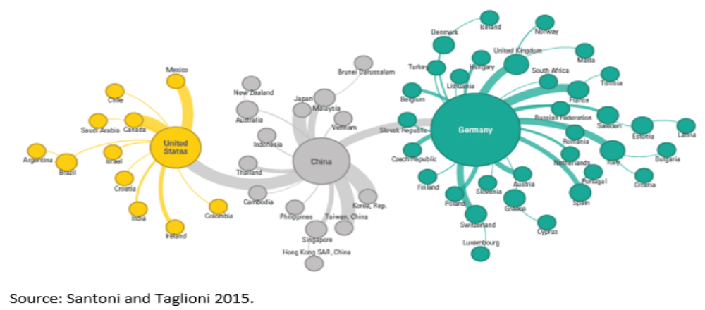
#1 Regional Factory
Notes:
Deeper integration in SEA and growing intra-regional trade as driving forces
More than 30% of their intermediate inputs from within the region
Little signs of Factory MENA: sourcing very little from within the region. They participate in the GVC mainly with Europe.
SEA deep regional trade agreements, good connectivity and infrastructure played a large role

Slide 4
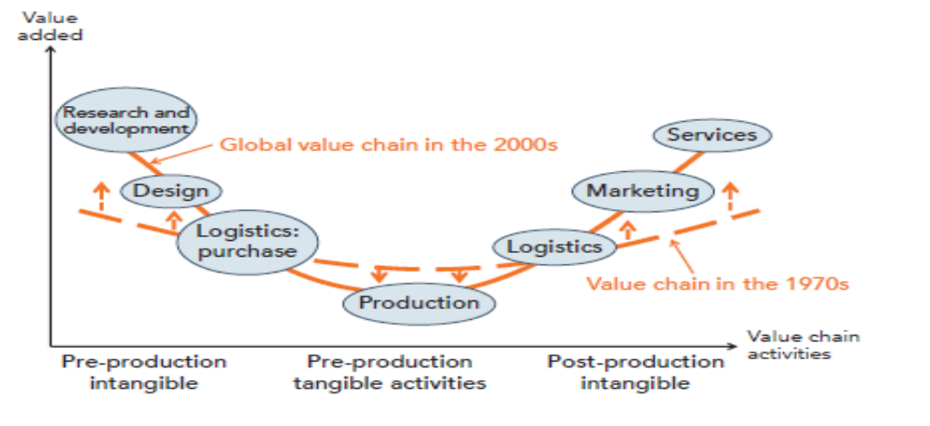
#2 Upgrading
Notes:
MENA participate mainly in forward GVC, not balanced and most of all there is not really an upgrading
The question here for MENA how to escape GVCtrap like China and India: We should not kick the ladder the industrial policy has a not so clean reputation but at this end this how China and the other countries made it :
Industrial policy with innovation system at heart, SEZ, clusters, etc.
Standards
Firms’ capabilities human capabilities, skills etc
Trade Facilitation, infrastructure and roads

Slide 5
#3 Infrastructure & Connectivity
Notes:
Tunisia as a case study, did not really succeed in exporting sophisticated goods in comparaison with Malaysia, China, etc
We find in a recent work that with Guedidi and Martinez Zarzoso that connectivity and behind the border barriers are extremely important for intermediate goods compared to final goods

Slide 6
Sustaining GVCs
Backward or forward participation impact pollution differently
  Shapiro (2021): most upstream industries (proxied by intermediates products) are dirtier and correlated with lower protection
  Supported by Guedidi and Baghdadi (2022): backward participation more positively correlated than forward with CO2 emissions incorporated in trade
Proportional tariff to the carbon embodied in imported goods, usually called a carbon tariff or carbon border adjustment
  Emissions Trading System, Carbon border adjustment mechanism

Slide 7
Sustaining GVC
Costs fall on developing countries
Risks to bear the burden from the EU Carbon Border Adjustment Mechanism, in particular those participating backward
  MENA countries participate mainly forward apart from Tunisia and Jordan

Slide 8
Sustaining GVC
More sustainable solution proposed by the report at the lead firm level:
  Lead firms can “price in” emissions impact of their production and inputs
  Strengthen production standards along their value chains
  Report data emissions
Firms participating in GVC with better environmental performance (WBES Green Module – MENA countries included Egypt Jordan Lebanon Tunisia Morocco) (Siewers, Martinez-Zarzoso and Baghdadi, forthcoming)
  More likely to adopt cleaner production practices, to face stricter external constraints, monitor CO2 emissions
The proposed solution could be integrated in comprehensive agreement focusing on GVC with environmental provisions ? any lesson from the Australian Indonesian agreement?

