Slide 1

CO2 emissions: Can GVC participation help decoupling?
(regional trends: 1990-2015)
Jaime de Melo and Jean-Marc Solleder
Comments for Special Session on
Sustaining Global Value Chains
28th. ERF Annual conferenceJaime de Melo, Jean-Marc Solleder, March 24: 15:00-16:30

Slide 2
ADB report on Sustaining GVCs
Comprehensive report on GVC landscape with focus on importance of infrastructure and transport. Complements WB WDR(2020) where focus was on moving up the GVC ladder (commodities, ltd. mfg., adv. Mfg. & services, innovative actirivites).
Useful distinction between place-based (SEZs) and sector-oriented industrial policies to help focus on trade costs.
Focus welcome. GVCs have shortened (2008 crisis+ COVID) + uncertainy trade-related tensions + ongoing digitalization (+conflicts).
GVC average length has shrunk by 50 km per year over 2012-18 (Miroudot and
Nordstrom, 2020).
Sustainability of GVCs requires moving toward net zero carbon.
Patterns of C02 emissions intensities (direct and indirect) across supply chains: characteristics (upstreamness), trends across regions to complement ADB report
List of countries and extra tables in annex

Slide 3
GVCs are mixed blessing for the environment: C02 footprint implications
Negative side
  Scale effects of trade and growth
  More shipping across countries and more waste in aggregate (e.g. In electronics via higher rate of technological innovation or plastics). ADB estimates 2.1 gigaton CO2e associated with international trade
  Industries might migrate to environmentally lax jurisdictions (pollution haven effect from falling trade costs and tighter environmental regulations)
Positive side
  knowledge flows across might lead to adoption of environmentally innovative products and technologies (Porter pollution ‘halo’ hypothesis)
  Lead firms in GVCs have brand names to protect in relational GVCs. Environmental impacts borne upstream while value created downstream. Lead firms can reduce scope 1 and 2 emissions from upstream suppliers in other jurisdictions.
Patterns of C02 emissions intensities (direct and indirect) across supply chains: characteristics (upstreamness), trends across regions to complement ADB report

Slide 4
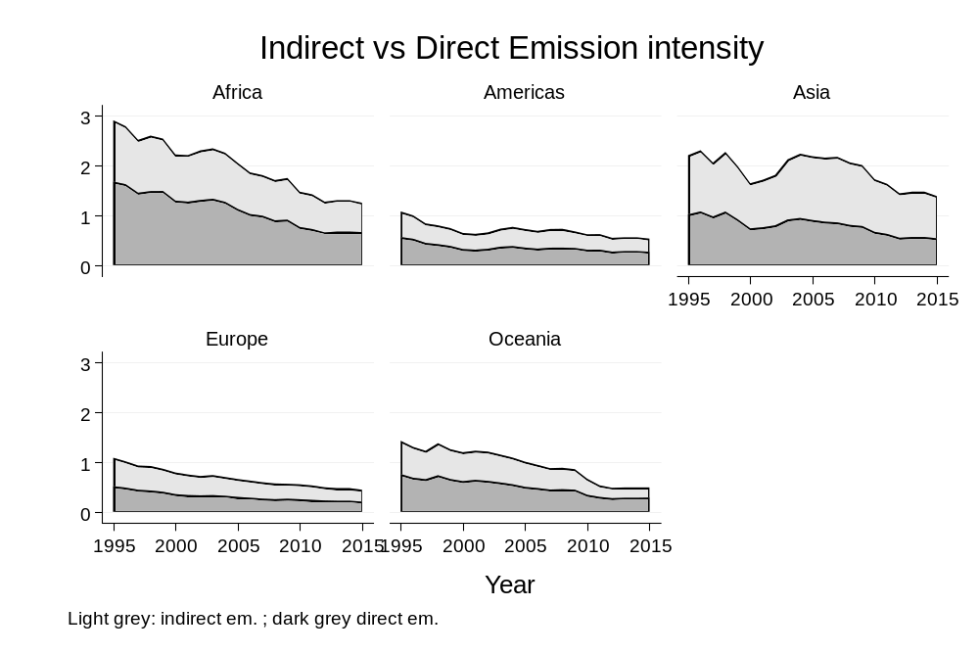
Direct and Indirect CO2 emissions by region
(emission intensity: kg/€; output-weighted averages)
Number of countries per region
Africa (51)
Americas (31)
Asia (47)
Europe (43)
Oceania (8)
Downward trend for CO2e(not all GHGs) across all regions.
Much higher intensity in Africa and Asia.
Higher indirect intensity in Asia than Africa

Slide 5
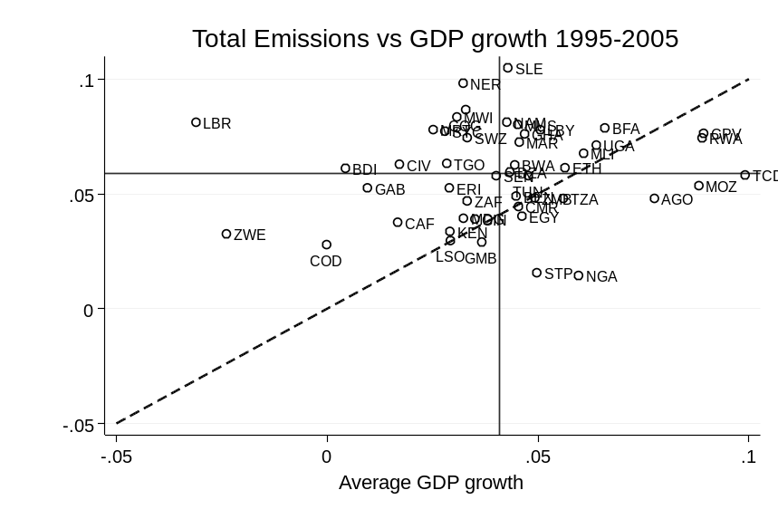
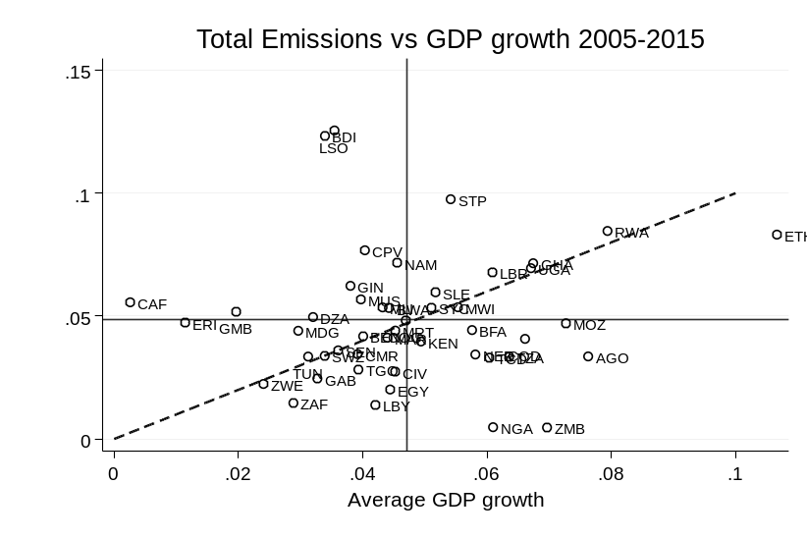
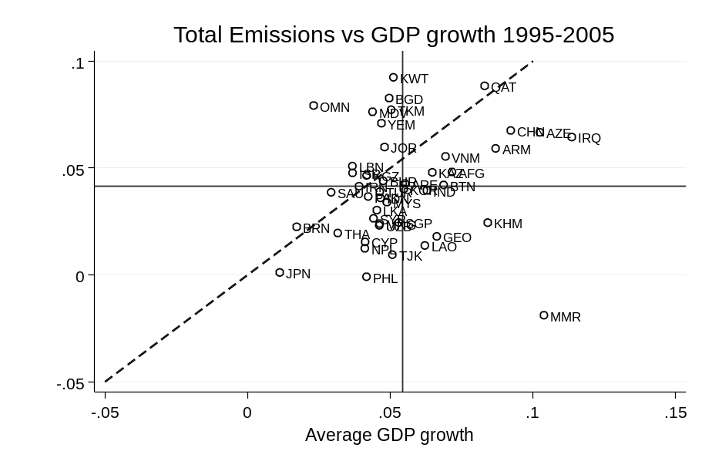
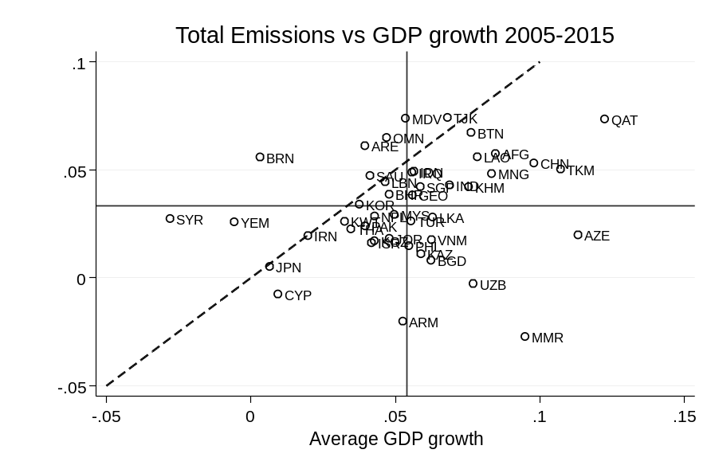
Decoupling? (countries below 45 line)
Vertical and horizontal lines show average growth rates
Africa
Decoupling in Africa in second period
Larger number of countries below 45⁰ line
Decoupling in Asia in both periods.
On average (intersection below 45⁰ line)
Number of countries below 45⁰ line
Asia

Slide 6
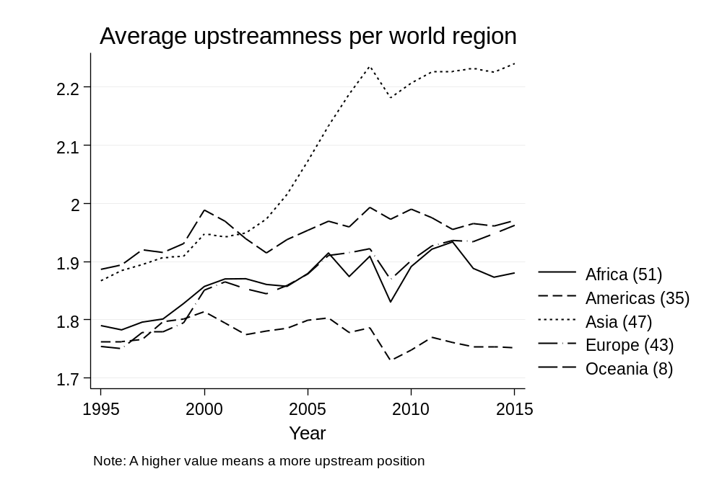
Upstreamness/Downstreamness
(output weighted)
Upstreamness (U) measures how far direct plus all indirect sector sales, Y, are from sales to final consumers, F. Sales are to intermediates, Z and final, i.e. Y≡ Z+F. Second round sales to intermediates (Z²)from first-round intermediates production. U measure is 1+ output weighted sales to other (downstream) sectors U≥1
U=1+F/Y +2x(Z¹/Y )+3x (Z²/Y) +.... (1)
See equation (5) in Antras and Chor (2018)
U=1 if all sales go to final demand. Larger shares sales to other sectors associated with higher U values. Large U values indicate high upstream position (far away from sales to consumers) from final use.
Downstreamness (D). replace Y with VA in (1) gives an estimate of the average number of production stages embodied in a sector’s output. D≥1. Gross -output weighted-averages of U and D across country-industries are equivalent.
See list of countries per region in annex.
Figure shows all regions are moving upstream (i.e. Sectors selling less to final consumers) except for Oceania In other words, world production is becoming more roundabout, or greater amount
Large sustained rise in Asia (“factory Asia”)
Low value in Oceania (small countries ++Australia and NZ distant from main trade partners). Both are obstacles to scale economies and to participation in GVCs.

Slide 7
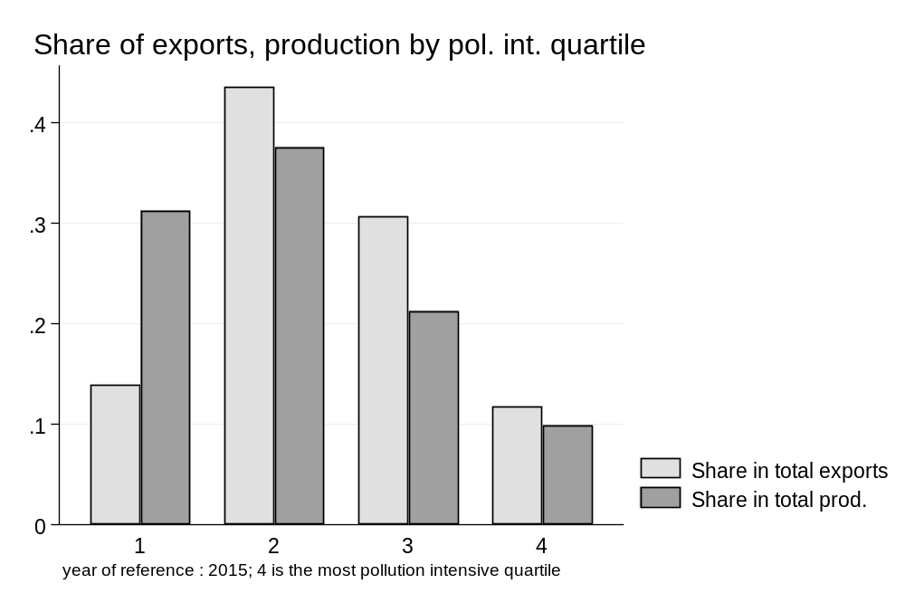
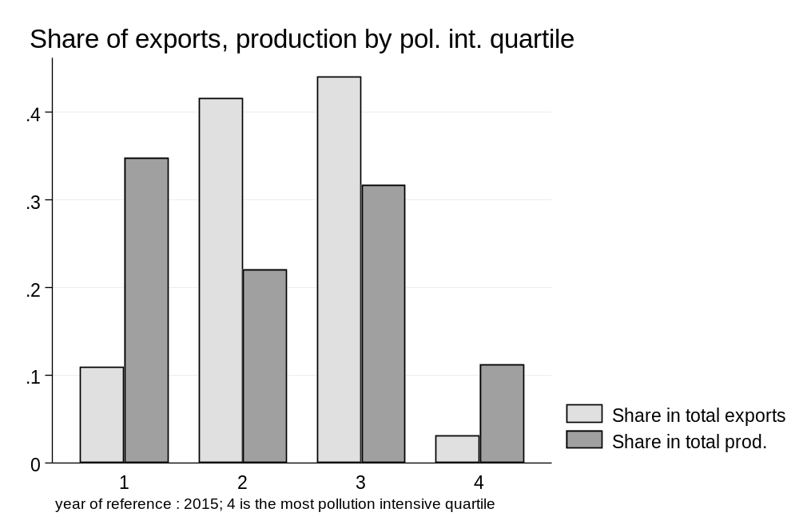
Comparing Distribution of CO2 intensity of production and exports
(by quartile of CO2e intensity by region for 2015; direct intensity)
Africa
Asia
Share of high CO2 intensity exports higher in Africa (11%) than in Asia (3%) but higher export share in Asia in third quartile

Slide 8
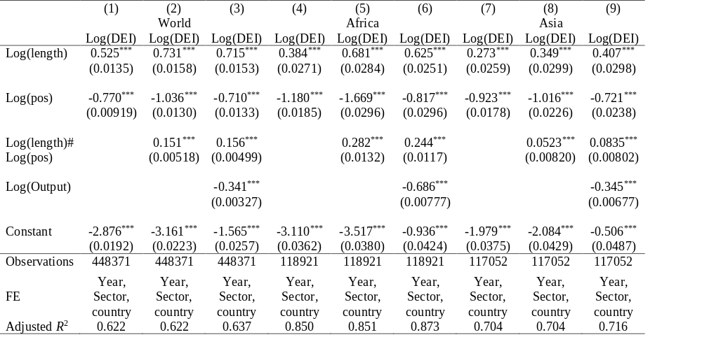
Some Correlates of CO2 emissions
Standard errors in parentheses. * p < 0.1, ** p < 0.05, *** p < 0.01
Notes : DEI: Direct Emission Intensity. Length= U +D; POS =U/D A larger value of Pos means more upstream.

Slide 9
Next steps
Stylized patterns : Some decoupling across regions; High CO2 intensity of export basket in Africa; Correlates of CO2 intensity of activities (upstream, GVC length, etc...)
Exploit RMRIO granularity for Policy
Asia fully integrated into GVCs. Policy issue is to detect potential comparative advantage in low CO2e activities and to incentivize them
Africa still to reap benefits of climbing up GVC ladder. Uncover a low CO2 intensity path. Use proximity metrics to explore product space and find clean products close to those currently exported.

Slide 10
References
Antras, P., D. Chor, T. Fally, R. Hillberry (2012) “Measuring Upstreamness of Production and Trade Flows”, American Economic Review, Papers and Proceedings, 102( 3), 412-16
Antras, P., D. Chor (2018) “On the measurement of Upstreamness and Downstreamness in Global Value Chains”, NBER WP #24185
Baldwin, R., and R. Freeman (2021) “Risks and global Supply chains: What we know and what we need to know”, NBER WP#29444
Cabernard, L. and S. Pfister (2021) “A highly resolved MRIO database for analysing environmental footprints and Green economy Progress”, Science on the Total Environment, 755
Lenzen, M., D. Moran, K. Kanemoto, A. Gesckhe (2013), “Building EORA: A Global multi-region input-output database at high country and sector resolution”, Economic Research Systems, 25(1), 20-49
Miroudot, S. and H. Nordstrom (2020) “Made in the World? Glvoal Value Chains in the Midst of Rising Protectionism”, Review of Industrial Organization, 57(2), 195-222
World Bank, 2020. Trading for Development in the Age of Global Value Chains, World Development Report, https://www.worldbank.org/en/publication/wdr2020

Slide 11
Annex

Slide 12
RMRIO countries : Africa
Algeria
Angola
Benin
Botswana
Burkina Faso
Burundi
Cameroon
Cape Verde
Central African Republic
Chad
Congo
Cote d'Ivoire
Democratic Republic of Congo
Djibouti
Egypt
Eritrea
Ethiopia
Gabon
Gambia
Ghana
Guinea
Kenya
Lesotho
Liberia
Libya
Madagascar
Malawi
Mali
Mauritania
Mauritius
Morocco
Mozambique
Namibia
Niger
Nigeria
Rwanda
Sao Tome and Principe
Senegal
Seychelles
Sierra Leone
Somalia
South Africa
South Sudan
Sudan
Swaziland
Tanzania
Togo
Tunisia
Uganda
Zambia
Zimbabwe

Slide 13
RMRIO countries : Americas
Antigua and Barbuda
Argentina
Aruba
Bahamas
Barbados
Belize
Bermuda
Bolivia
Brazil
British Virgin Islands
Canada
Cayman Islands
Chile
Colombia
Costa Rica
Cuba
Dominican Republic
Ecuador
El Salvador
Greenland
Guatemala
Guyana
Haiti
Honduras
Jamaica
Mexico
Nicaragua
Panama
Paraguay
Peru
Suriname
Trinidad and Tobago
United States
Uruguay
Venezuela

Slide 14
RMRIO countries : Asia
Afghanistan
Armenia
Azerbaijan
Bahrain
Bangladesh
Bhutan
Brunei
Cambodia
China
Cyprus
Georgia
India
Indonesia
Iran
Iraq
Israel
Japan
Jordan
Kazakhstan
Kuwait
Kyrgyz Republic
Laos
Lebanon
Malaysia
Maldives
Mongolia
Myanmar
Nepal
North Korea
Oman
Pakistan
Palestine
Philippines
Qatar
Saudi Arabia
Singapore
South Korea
Sri Lanka
Syria
Tajikistan
Thailand
Turkey
Turkmenistan
United Arab Emirates
Uzbekistan
Vietnam
Yemen

Slide 15
RMRIO countries : Europe
Albania
Andorra
Austria
Belarus
Belgium
Bosnia and Herzegovina
Bulgaria
Croatia
Czech Republic
Denmark
Estonia
Finland
France
Germany
Greece
Hungary
Iceland
Ireland
Italy
Latvia
Liechtenstein
Lithuania
Luxembourg
Macedonia
Malta
Moldova
Monaco
Montenegro
Netherlands
Norway
Poland
Portugal
Romania
Russia
San Marino
Slovak Republic
Slovenia
Spain
Sweden
Switzerland
Ukraine
United Kingdom
Yugoslavia

Slide 16
RMRIO countries : Oceania
Australia
Fiji
French Polynesia
New Caledonia
New Zealand
Papua New Guinea
Samoa
Vanuatu

Slide 17
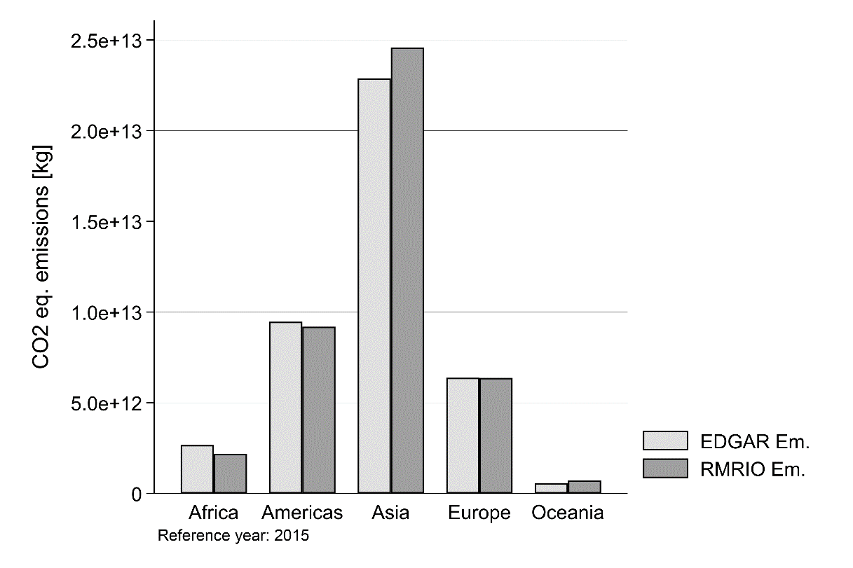
Data base: high granularity
Estimates from new extensive data base with RMRIO (for Resolved MRIO) that merges EORA temporal and country coverage (Lenzen et al. (2015) coupled with EXIOBASE sectoral data.
EORA’s emissions sourced from EDGAR but RMRIO aggregate of CO2, CH4, N2O, hydrofluorocarbon and perfluorinated compound, into a single measure in CO2 equivalent (CO2e).
RMRIO (Cabernard and Pfister(2021).Data for 193(J-countries) and 163 (S-sectors) over the period 1995-2015.
Estimates of CO2 footprint in GVCs bases on 193 countries and 163 sectors for a potential of Z_{ij}^{rs} = (163*193)² ≈ 10⁹ input purchases across country-industry pairs. High granularity data base. 22% of lines at sector level have 0 total emissions reflecting that some sectors are not be produced in some countries.
Comparison EDGAR- RMRIO shows similar footprint estimates from the two CO2 databases.

Slide 18
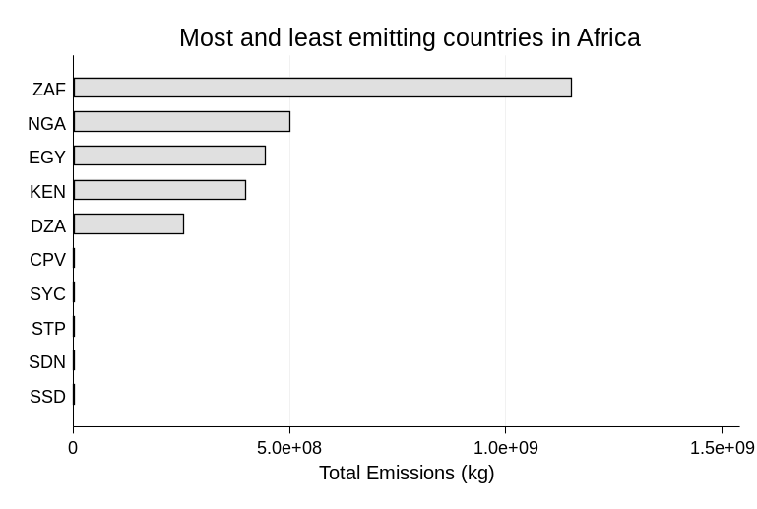
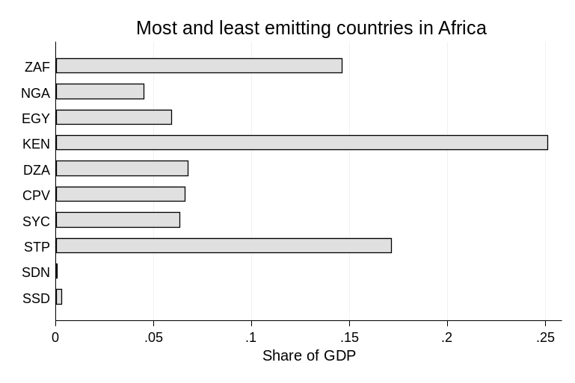
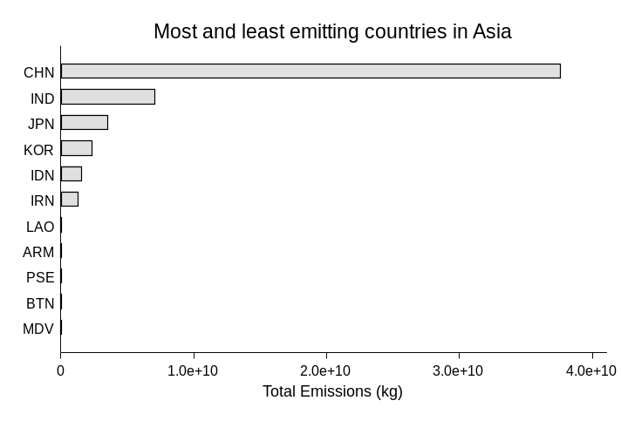
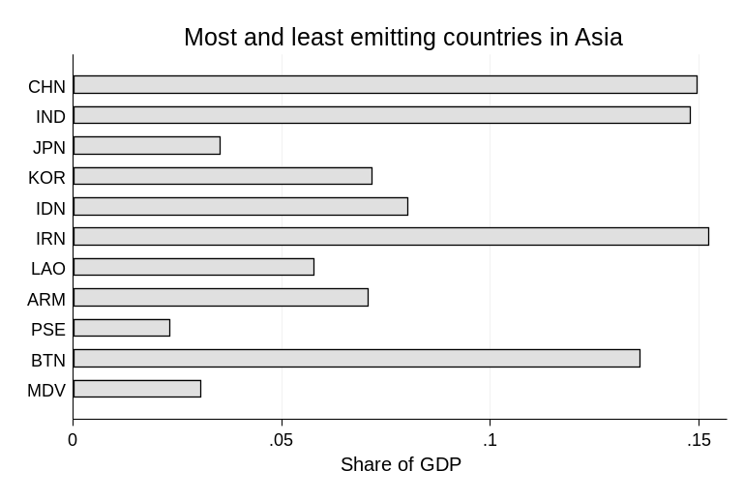
top 5 and bottom 5 CO2 emitters
(intensity and corresponding share of GDP)
Africa
Asia

Slide 19
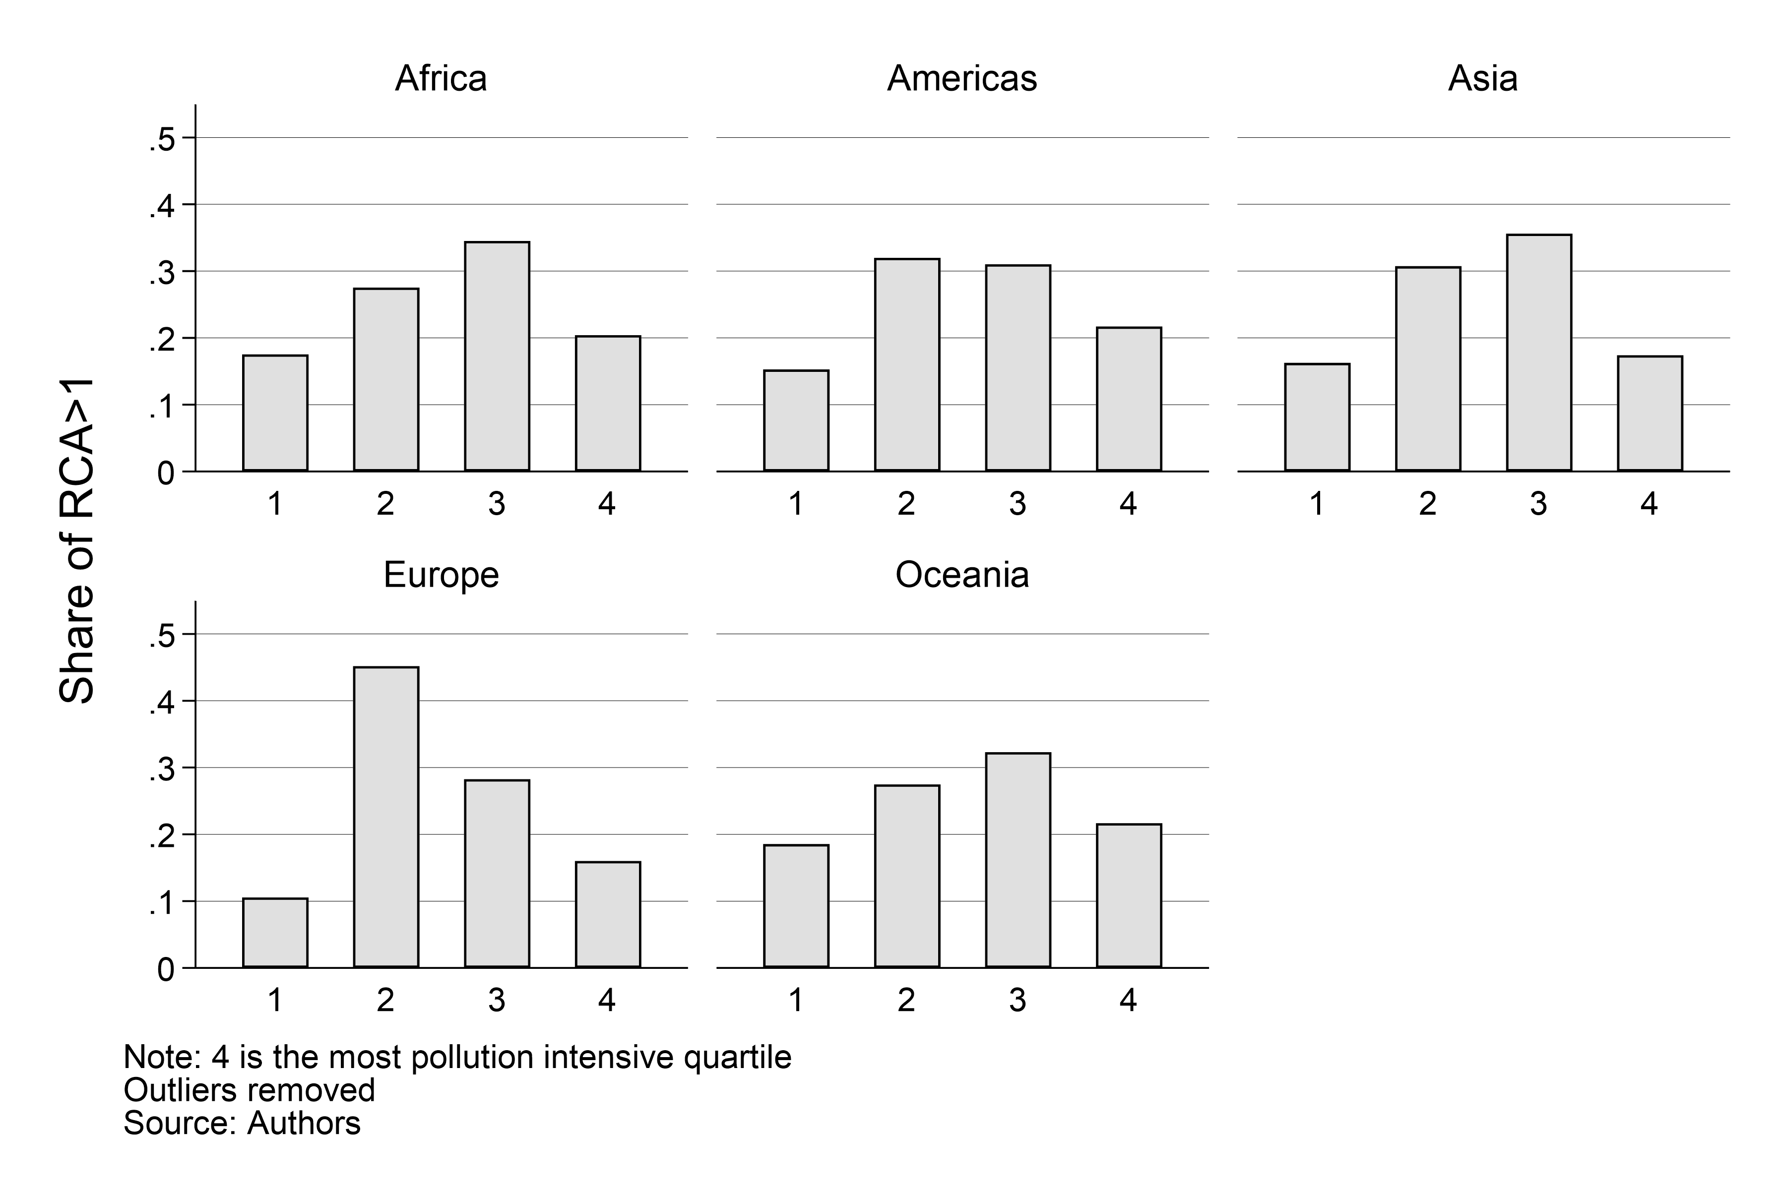
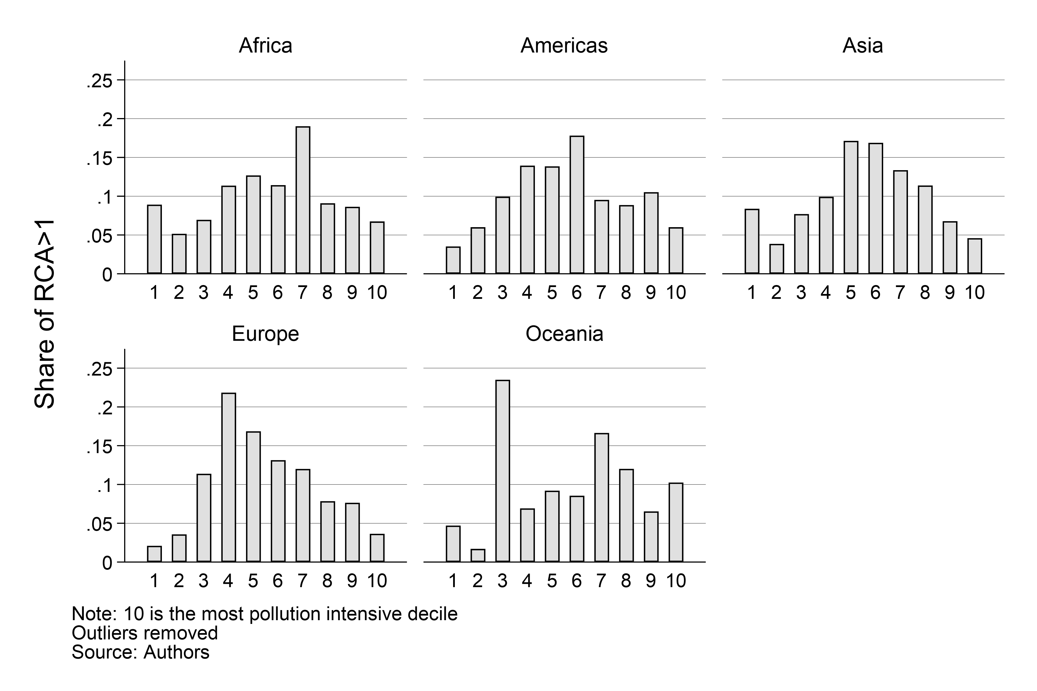
Carbon intensity of revealed Comparative advantage (RCA>1)
(by quartile and by decile of CO2 intensity)
Explore further CO2 intensity of patterns of comparative advantage

