Slide 1
ERF Annual Conference
Governing Health Futures in a Digital World
March 2022

Slide 2
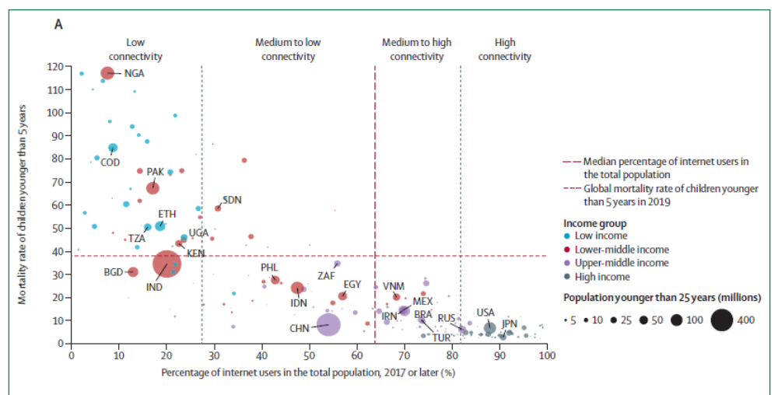

Slide 3
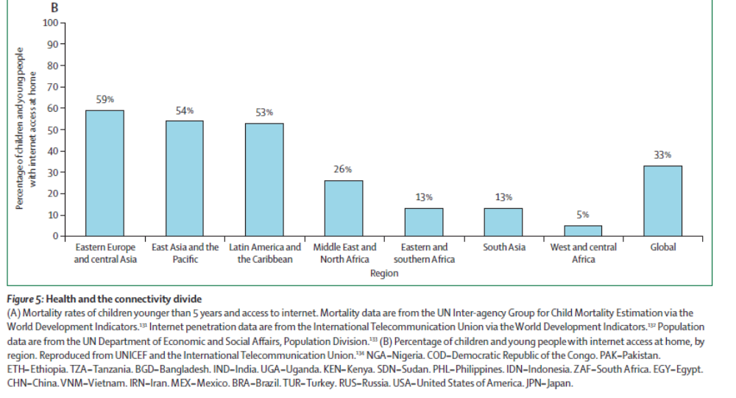

Slide 4
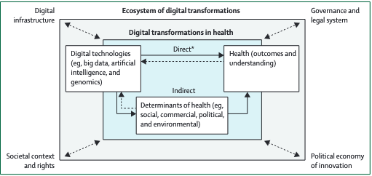
Conceptualising digital transformations in health

Slide 5
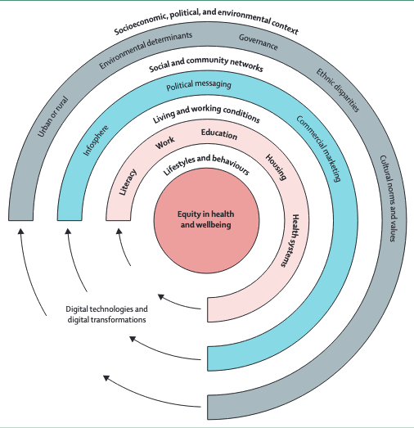
Digital technologies interact directly and indirectly with the social, political, commercial, and environmental determinants of health

Slide 6
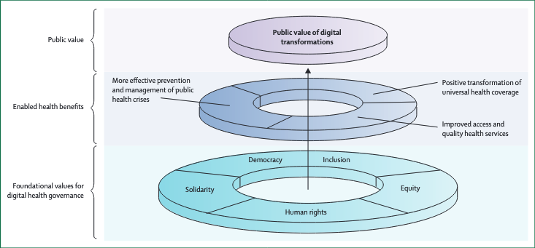
Health for All values as the foundation for digital transformations in health

Slide 7
Governance of New Technology
      Societal norms around new technologies
      Ethical standards for emerging technologies
      Algorithmic accountability and transparency
7
Notes:
Ethical standards for coding: e.g. Institute for Electrical and Electronics Engineers new standards

Slide 8
Data Governance
      Open databases
      Data trusts and cooperatives
      Common data protocols for the development of emergent technologies
      Manage the privacy-cybersecurity-human rights nexus
8
Notes:
Open databases for employment and skills supply and demand.

Slide 9
Focused Public Investment
      National/sub-national funding and PPPs for digital infrastructure and R&D
      Transforming high-risk public service roles
      Remote health access and delivery
9

